Slide 1
Agile Methodology

Slide 2
Contents
What is Agile Methodology?
Advantages of Agile
Types of Agile Methodology
Scrum
Sprints
Scrum Roles
Scrum Artifacts
Scrum Events/Ceremonies

Slide 3
What is Agile Methodology?
Agile Methodology is a practice that promotes continuous iteration of development and testing throughout the software development lifecycle of the project.
In the Agile model in software testing, both development and testing activities are concurrent, unlike the Waterfall model.
Instead of a single-pass development of 6 to 18 months where all the requirements and risks are predicted upfront, Agile adopts a process of frequent feedback where a workable product is delivered after 1 to 4 weeks iteration

Slide 4
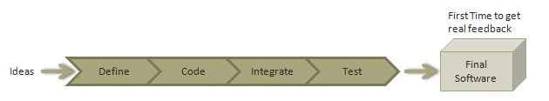
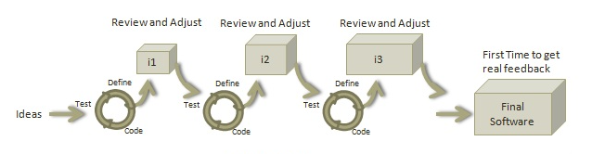
Agile Vs Waterfall
Waterfall:
Agile:

Slide 5
Advantages of Agile
It is focused client process. So, it makes sure that the client is continuously involved during every stage.
Agile teams are extremely motivated and self-organized so it likely to provide a better result from the development projects.
Agile software development method assures that quality of the development is maintained
The process is completely based on the incremental progress. Therefore, the client and team know exactly what is complete and what is not. This reduces risk in the development process.
Product is developed fast and frequently delivered (weeks rather than months.)

Slide 6
Types of Agile Methodology
Scrum
Extreme Programming (XP)
Lean Software Development
Kanban
Crystal
Feature-Driven Development (FDD)
Dynamic Systems Development Method (DSDM)

Slide 7
What is Scrum?
Scrum is an agile development methodology used in the development of Software based on an iterative and incremental processes.
Scrum is adaptable, fast, flexible and effective agile framework that is designed to deliver value to the customer throughout the development of the project.
The primary objective of Scrum is to satisfy the customer’s need through an environment of transparency in communication, collective responsibility and continuous progress.

Slide 8
What are Sprints?
With scrum, a product is built in a series of repetition called sprints.
It breaks down big complex projects into bite-size pieces. It makes projects more manageable, allows teams to ship high quality, work faster, and more frequently.
The sprints give them more flexibility to adapt to the changes.
Sprints are a short, time-boxed period for Scrum team that works to complete a set amount of work.

Slide 9
Scrum Roles
Product Owner - Is the representative of the stakeholders and customers who use the software. They focus on the business part, translate the vision of the project to the team, validate the benefits in stories to be incorporated into the Product Backlog and prioritize them on a regular basis.
Scrum Master acts as a facilitator for the agile delivery team. They leads the team guiding them to comply with the rules and processes of the methodology. Scrum master manages the reduction of impediments of the project and works with the Product Owner to maximize the ROI(Return on Investment).
Scrum Team are a group of professionals with the necessary technical knowledge who develop the project jointly carrying out the stories they commit to at the start of each sprint. Its main tasks are programming, analysis, testing, etc.
Stakeholders is an individual or a group of people who are impacted by the outcome of a product. Stakeholders in Scrum are interested in the product’s success. They can be within or outside the company that is sponsoring the project.

Slide 10
Scrum Artifacts
Product Backlog
Sprint Goal
Sprint Backlog
Burn down chart

Slide 11
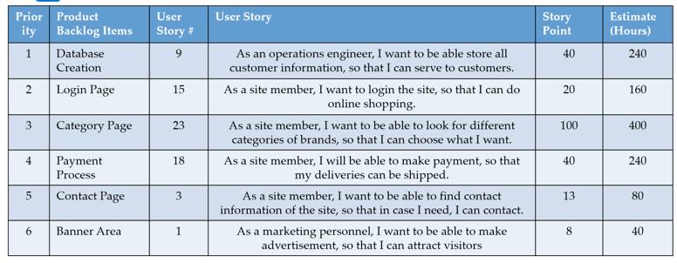
Product Backlog
It is basically list of requirements including priorities and estimation of each requirements.
It’s ordered by priority and every item is called a User story. Every user story gets a unique ID.
As a rule, user stories have the following format: As a [User Role], I want to [feature body] so that [User profit].

Slide 12
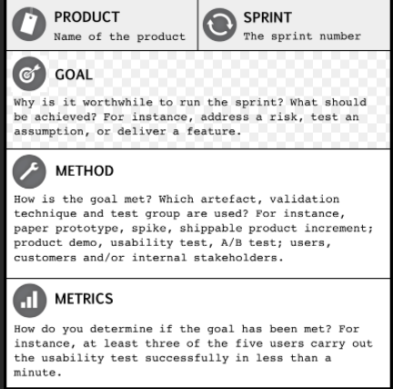
Sprint Goal
A Sprint goal shows the desired outcome of an iteration that provides a shared goal to the team, which goal has to be defined before the team starts the Sprint in order to focus to get this goal.
Step for Creating a Sprint Goals
Product owner presents the ordered backlog items to the team.
Team discusses and understands the work for this Sprint.
Team forecasts and commits on the items that can be done.
Team creates the Sprint Goal for this Sprint.

Slide 13
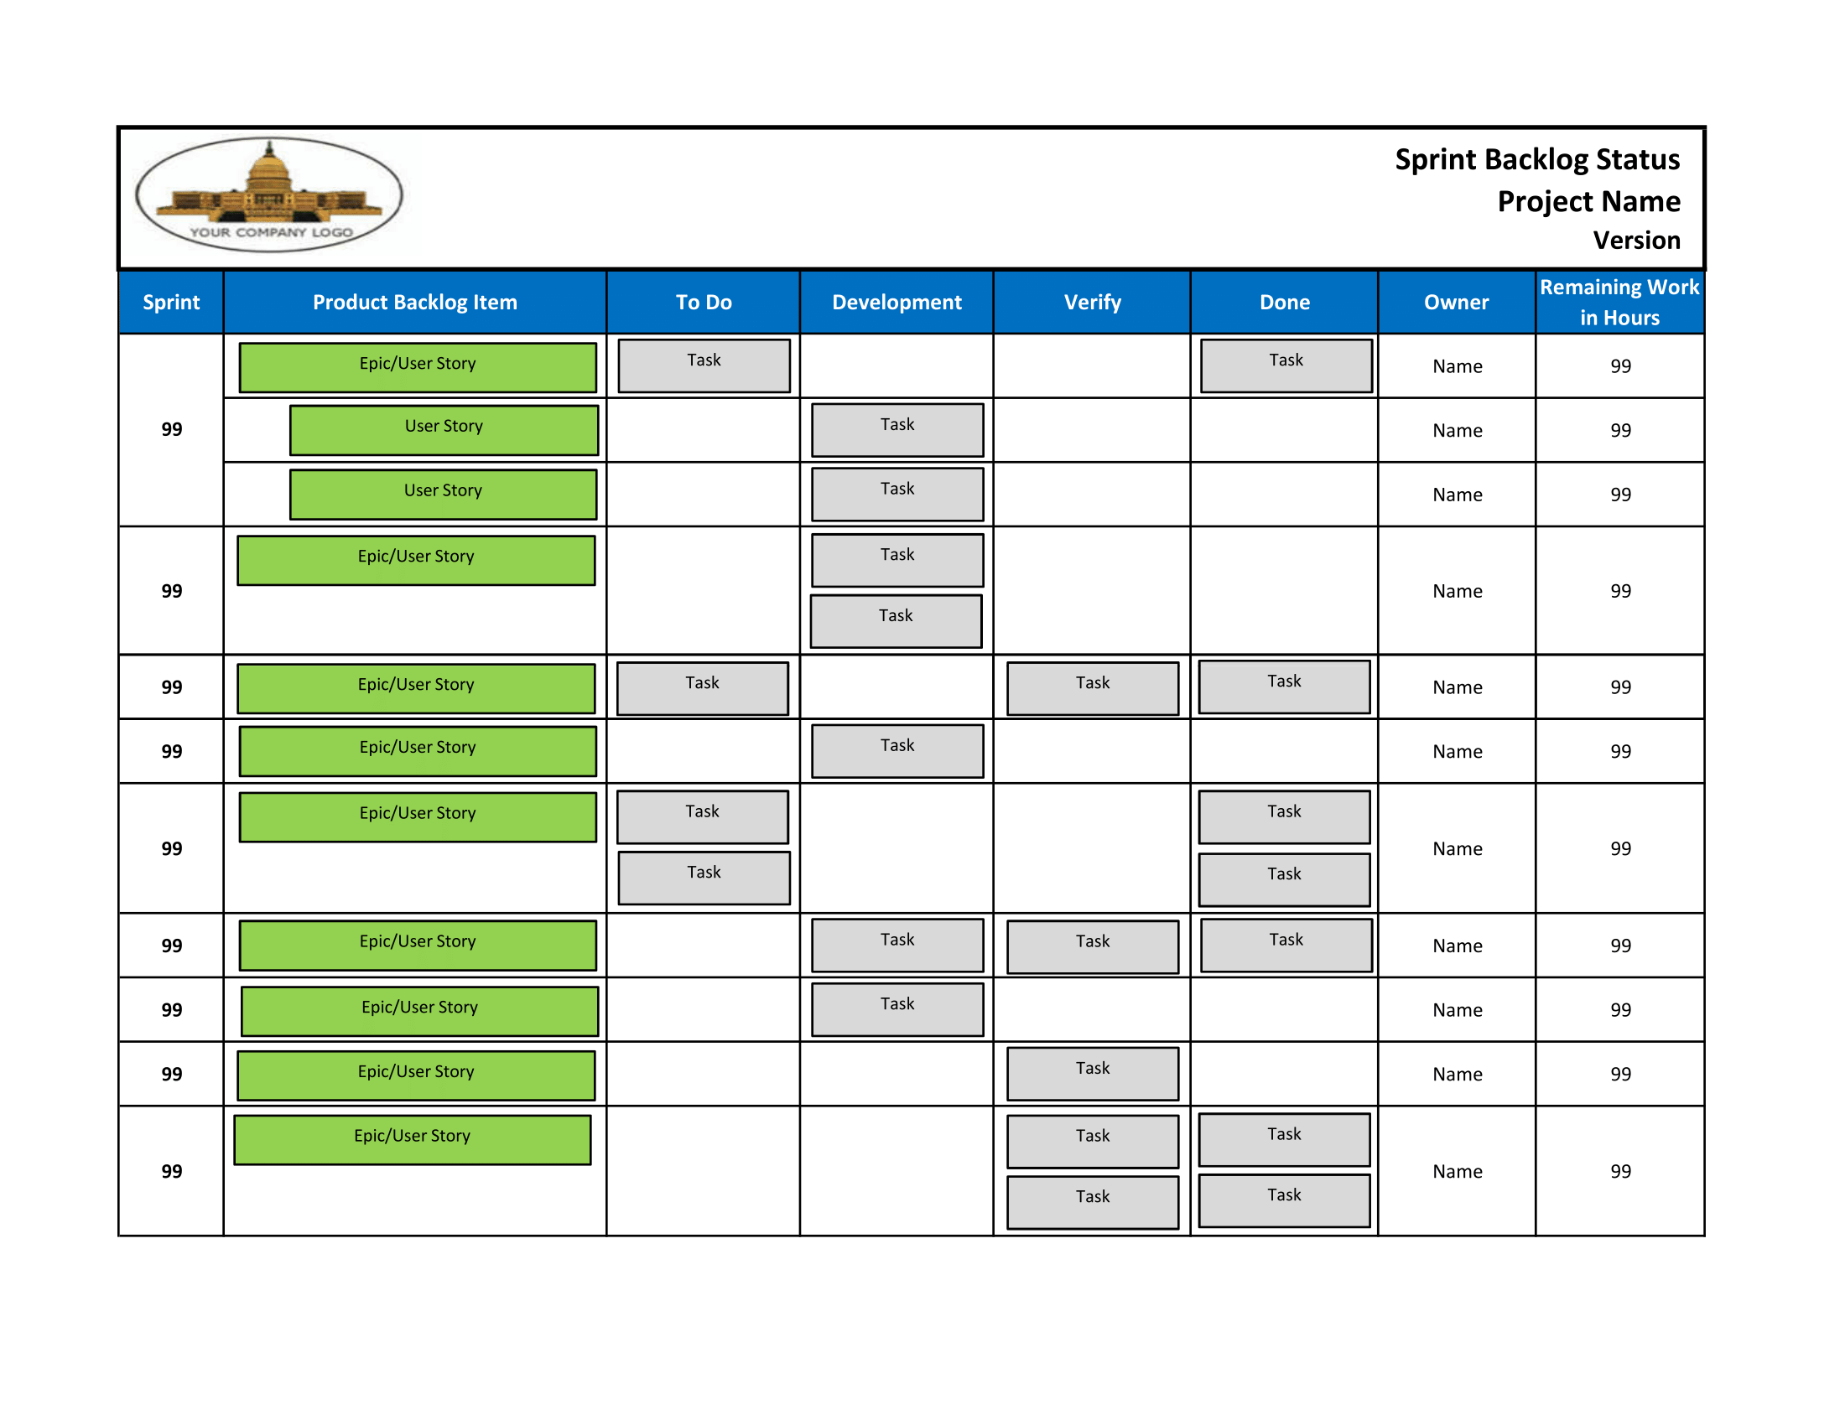
Sprint Backlog
It is subset of product backlog items selected to be executed during each sprint.
Sprint Backlog is composed of the Sprint Goal (why), the set of Product Backlog items selected for the Sprint (what), as well as an actionable plan for delivering the Increment (how).
This include plan to deliver product increment also. As new work is required to be added, the development team or scrum team adds it to sprint backlog.

Slide 14
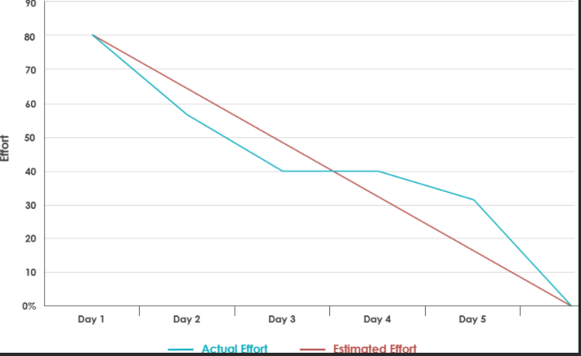
Burn down chart
The burn down chart plots remaining effort versus days. This gives estimation on when the work is going to be completed.
Helps the team to track the progress
Since it shows the progress on daily basis, it help scrum master to predict if a team will be able to achieve the target.

Slide 15

Scrum Events/Ceremonies
Product Backlog Refinement Meeting
Sprint Planning Meeting
Daily Stand-up Meeting
Sprint Review
Sprint Retrospective

Slide 16
1. Product backlog refinement
What happens in these meetings?
The product owner needs to highlight what product features are a priority for customers and must be developed immediately.
The product owner breaks down these items into user stories that have to be worked on in the next sprint. At the end of the meeting, the project team knows the customer’s new requirements and the crucial items to be delivered in the following sprint.

Slide 17

B. Who attends this Scrum ceremony? The Scrum master, product owner, and a few members of the scrum team.
C. How long do they last? It should last around 2 hours for a two-week sprint, and for a three-week sprint, it should last no more than 3 hours.

Slide 18
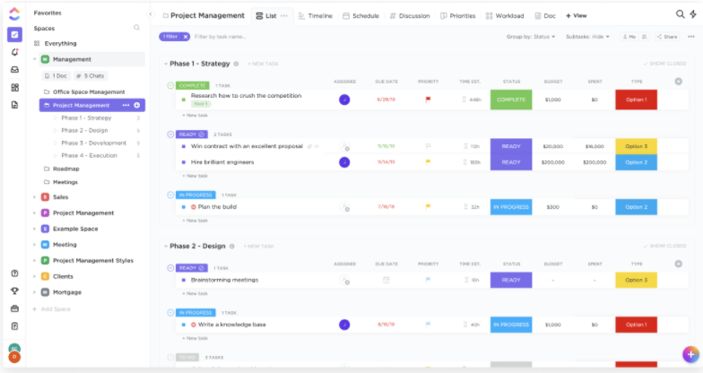

Slide 19
2. Sprint Planning Meeting
What happens in these meetings?
The sprint planning meeting kicks off the sprint.
The goal of this meeting is to develop realistic Sprint backlog and define the highest priority tasks which need to be done during the length of each Sprint.
The product owner is responsible for explaining the backlog items to the development team and open discussion is expected from both ends to clear all kinds of ambiguities.
At the end of the sprint meeting, the entire Scrum development team has to agree on the sprint goal they have set for themselves and make a sprint commitment to achieving it.

Slide 20
B. Who attends this Scrum ceremony? The product owner, Scrum Master, and the scrum team.
C. How long do they last? The length of the sprint planning meeting varies with the sprint duration. For a 2-week sprint, it should last around 4 hours, and for a 3-week sprint, it should last no more than 6 hours.

Slide 21
3. Daily Stand-up Meeting
What happens in these meetings?
Daily Scrum meeting, or daily standups occur on daily basis where only task-statuses and hindrances are discussed
There’s essentially a three questions agenda which is presented before each team member to get an overview of the task progress. These questions are:
What did you accomplish yesterday?
What are you working on today?
Are there any impediments in your way?

Slide 22
B. Who attends this Scrum ceremony? The Scrum Master and the scrum team.
C. How long do they last? They are typically held at the same time and same place every day and are strictly timeboxed to no longer than 15 minutes.

Slide 23
4. Sprint Review
What happens in these meetings?
At the end of each Sprint, a Sprint Review meeting is held.
The core objective of this meeting is to demonstrate the functionality of the product and what has been achieved during a particular Sprint.
The team also reports:
What tasks have been completed
What user stories have been addressed
What features have been added

Slide 24
B. Who attends this Scrum ceremony? Key stakeholders, like investors and customers, attend these ceremonies. Other attendees include the Scrum master, product owner, and scrum team.
C. How long do they last? A sprint review should last one hour per week of the sprint. For example, a two-hour sprint review should be scheduled for a two-week sprint.

Slide 25
5. Sprint Retrospective
What happens in these meetings?
After a review, the Scrum team gathers to reflect on how the work was carried out.
Each individual member should give their perspective on these three Scrum questions:
What process went well over the last sprint?
What tasks didn’t go so well?
What could be improved?
The Scrum Master then gives their feedback and suggestions to improve the team’s performance.

Slide 26
B. Who attends this Scrum ceremony? The Scrum Master and the scrum team.
C. How long do they last? Just like a sprint review, for a two-week sprint, a sprint retrospective should last around 2 hours, and for a three-week sprint, it should last no more than 3 hours.

Slide 27
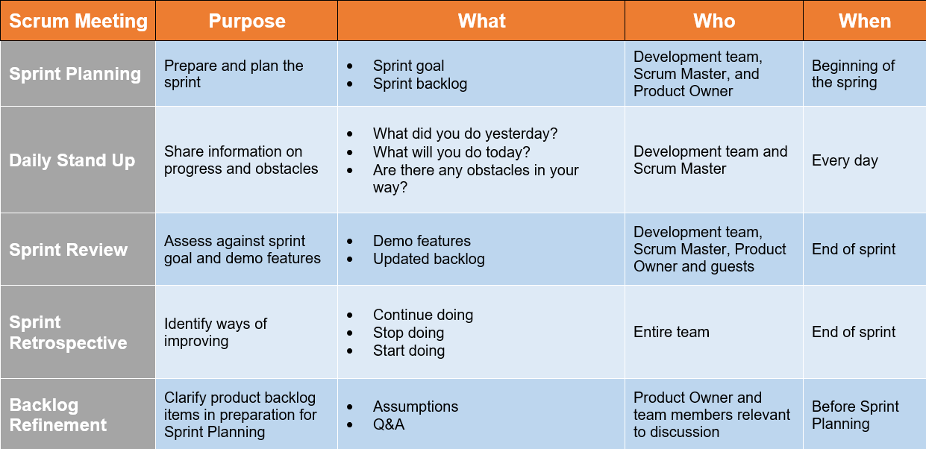

Slide 28
THANK YOU

